Slide 2
An Intro to JavaScript
A lecture by Joshua Doucet

Slide 3
References
DeGroat, T. (2019, August 14). The History of JavaScript: Everything You Need to Know. Retrieved July 2, 2020, from https://www.springboard.com/blog/history-of-javascript/
European Computer Manufacturers Association. (2020). ECMAScript Language Specification. Retrieved July 4, 2020, from https://www.ecma-international.org/ecma-262/11.0/index.html#sec-intro
Mandwarya, A. (2020, June 05). How to use Async Await in JavaScript. Retrieved July 20, 2020, from https://medium.com/javascript-in-plain-english/async- await-javascript-5038668ec6eb
Mozilla. (2020, June). What is JavaScript? Retrieved July 1, 2020, from https://developer.mozilla.org/en- US/docs/Learn/JavaScript/First_steps/What_is_JavaScript
Refsnes Data. (2020). JavaScript and HTML DOM Reference. Retrieved July 15, 2020, from https://www.w3schools.com/jsref

Slide 4
What is JavaScript?
A scripting programming language
Used to add complex features to web pages
It is coupled with HTML and CSS to design websites
JavaScript allows for dynamically updated web content, animations, and interactive controls within a web page.
Used in Facebook, YouTube, eBay, Google Maps, and many many MANY more.
Side note:
HTML (Hypertext Markup Language) is used to give structure and meaning to web pages
CSS (Cascading Style Sheets) is a language used to style webpages (colors, fonts, object placement)

Slide 5
Some History
Developed in Sep 1995 by Branan Eich who also worked on Netscape
Early versions called Mocha, LiveScript
Scripting standard maintained by The ECMA (European Computer Manufacturers Association
Became popular in 2005 due Ajax , a suite of technologies to make web pages more like native desktop apps.

Slide 6
More details
Java != JavaScript
Java is compiled
JavaScript is interpreted
Usually runs client-side (on computer running a web browser)
Node.js allows JavaScript to run on servers
Programs using JS (JavaScript) are far reaching, large audience with easy access. (Web browsers)

Slide 7
More details
JavaScript (Officially ECMAScript) has 9 main versions as of 2018
Version 3 added regex support and try catch functionality
Version 5 added JSON support
Version 6 added array search functionality, and default parameters
Version 7 added exp operator **
Version 8 added async functions

Slide 8
JavaScript Coding Basics

Slide 9
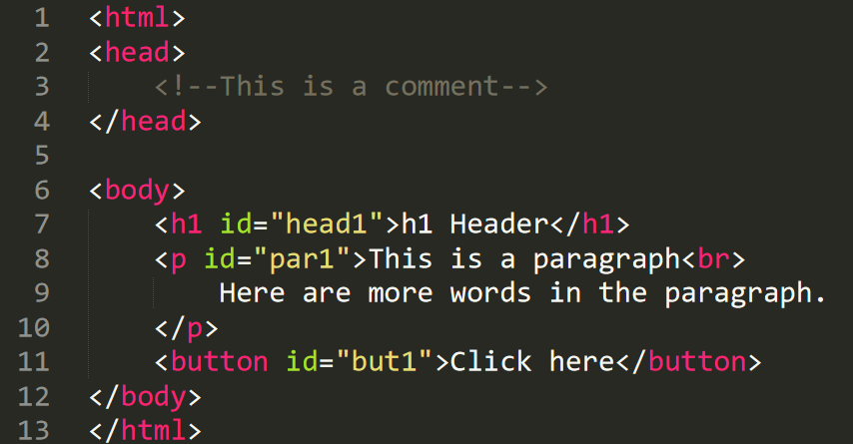
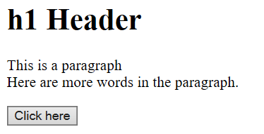
HTML Example (Context is needed to understand JavaScript)
htmlexample.html in text editor
htmlexample.html in web browser

Slide 10
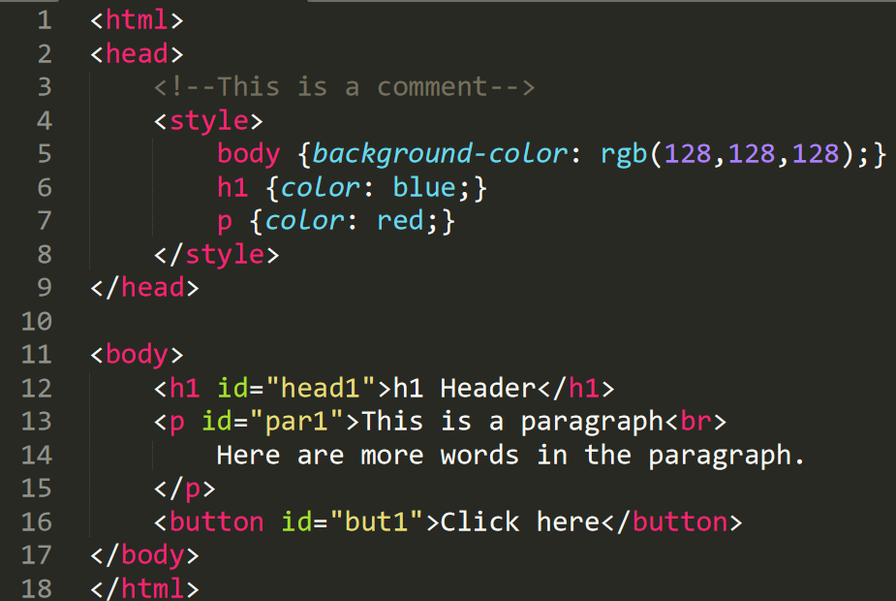
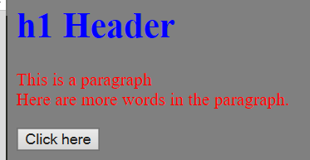
HTML Example with CSS

Slide 11
Some JS Need to Know
JavaScript is built into web browsers and does not require separate software to write code.
Simply use your favorite text editor or a supported IDE
JavaScript code can be embedded in HTML tags or nested inside <script> </script> tags.
JS can be placed in the head or body tags of HTML
JS can be placed in an external .js file and imported into an HTML doc.

Slide 12
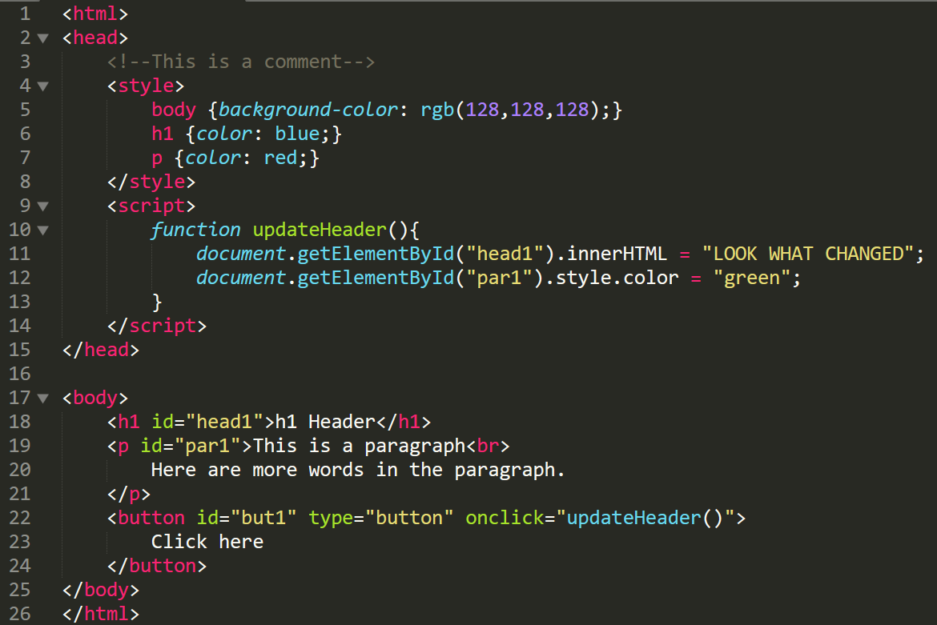
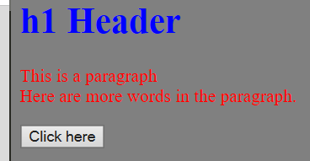
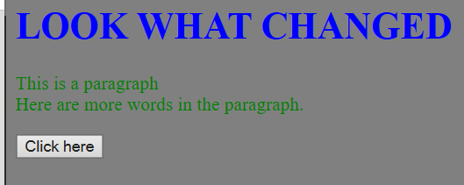
Add some JS to the Example
Before Click
After Click

Slide 13
Arithmetic Operations
JS uses infix notation (5 + 4) or (6 * 7)
+ Addition
- Subtraction
* Multiplication
/ Division
% Modulus
++ Increment (prefix and postfix)
-- Decrement (prefix and postfix)

Slide 14
Assignment Operators
= y = x //value of x stored in y
+= y += x // y = y + x
-= y -= x //y = y - x
*= y *= x //y = y * x
/= y /= x //y = y / x
%= y %= x // y = y % x

Slide 15
Concatenation String Operators
+ string3 = string1 + string2
//If string1 = “Hello” and string2 = “ World”
//then string3 would become “Hello World”
+= string1 += string2
//If string1 = “Hello” and string2 = “ World”
//then string1 would become “Hello World”

Slide 16
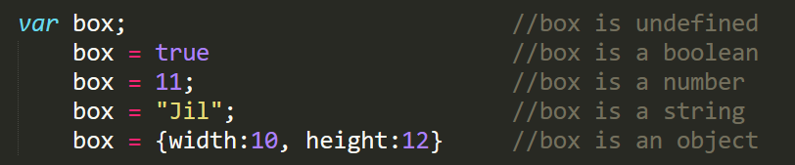
JS Data Types and Variables
Has 5 basic types: undefined, boolean, numbers, strings, and objects
JS uses dynamic types, meaning that values of different types can be assigned to the same variable.

Slide 17
Comparison Operators
== equal value
=== equal value and type
!= not equal value
!== not equal value OR not equal type
> greater than
< less than
>= greater than OR equal
<= less than OR equal

Slide 18
Logical and Bitwise Operators
Logical
&& and
|| or
! not
Bitwise
& AND
| OR
~ NOT
^ XOR
<< Left Shift
>> Right Shift

Slide 19
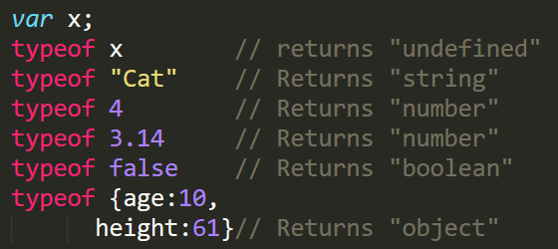
typeof operator and null vs. undefined
typeof is a unary operator that returns the type of the item to the right of it
null and undefined are equal in value, but null is an object and undefined has no type (i.e. undefined)

Slide 20
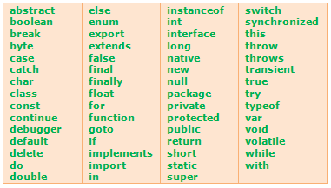
Reserved Words (Varies by JS version)
http://www.corelangs.com/js/basics/variables.html

Slide 21
Array Basics
Initializing Arrays
var colors = ["Red", "Blue", "Green", "Purple"];
var colors = [255000000, "Blue", "Green", "Purple"];
var colors = new Array("Red", "Blue", "Green", "Purple");
Accessing Arrays
var color = colors[1]; // color = “Blue”
Changing Elements
colors[1] = “Yellow” // colors = ["Red", “Yellow",
// "Green", "Purple"]
Push and Pop
colors.pop(); // colors = ["Red", “Yellow", “Green”];
colors.push(“Silver”);
colors.push(“Gold”); // colors = ["Red", “Yellow", “Green”,
“Silver”, “Gold”];

Slide 22
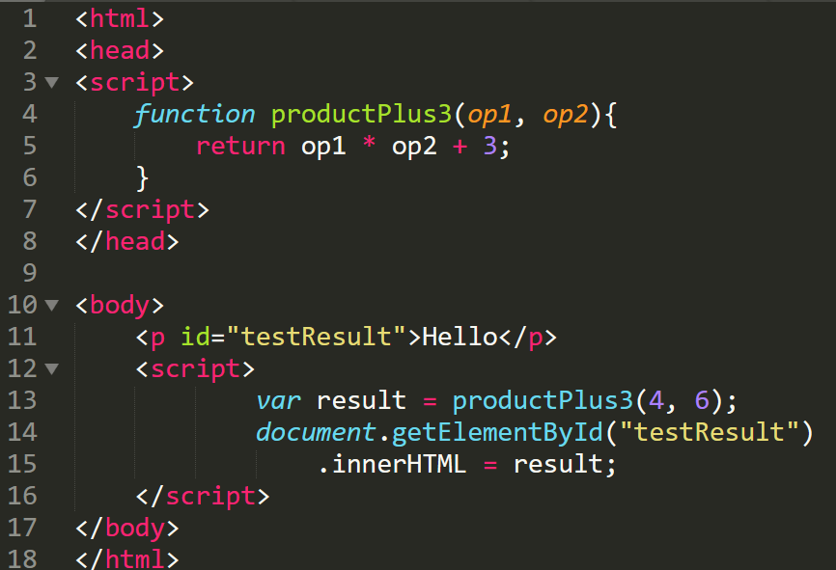

Function Creation and Invocation
HTML Output

Slide 23
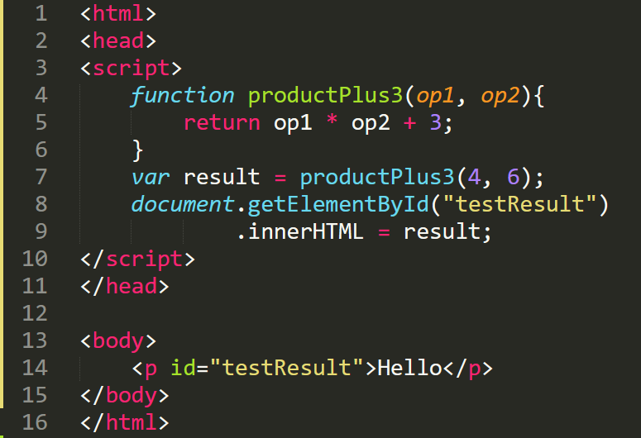

Incorrect Function Invocation
Attempt to alter element with ID “testResult” at wrong time.
HTML Output

Slide 24
Syntax: Branching with if, else/if, else
if(condition1){
//Do this if condition1 true
}else if(condition2){
//Do this if condition1 false and //condition2 is true
}else{
//Do this if condition1 and condition2 //are both false
}

Slide 25
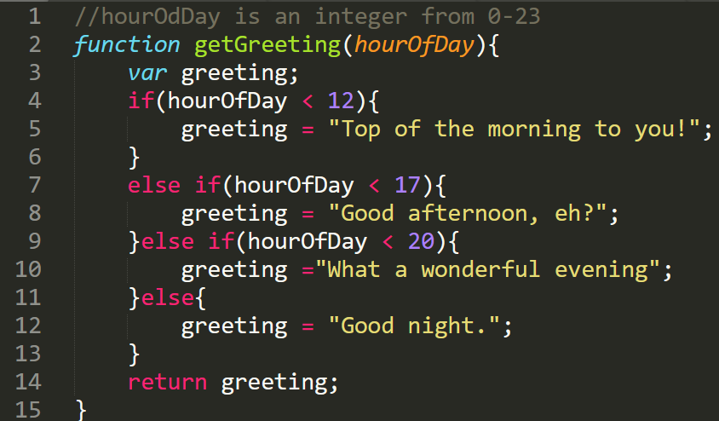
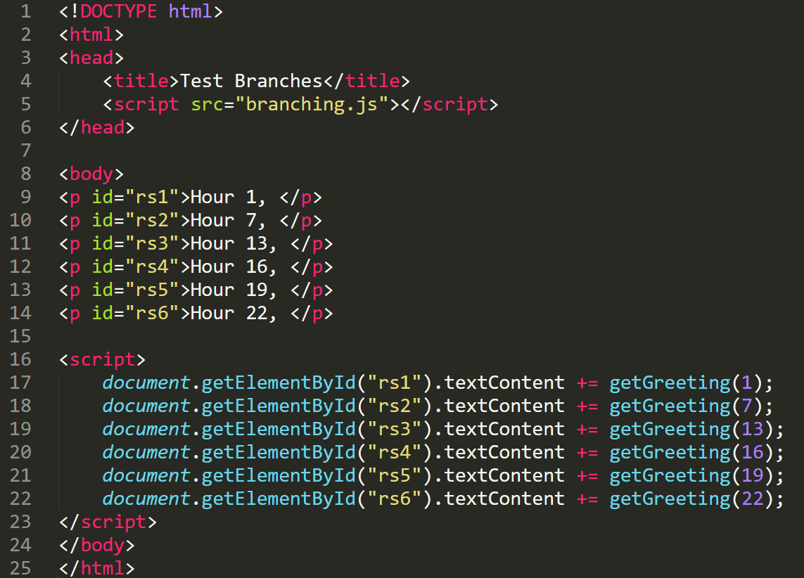
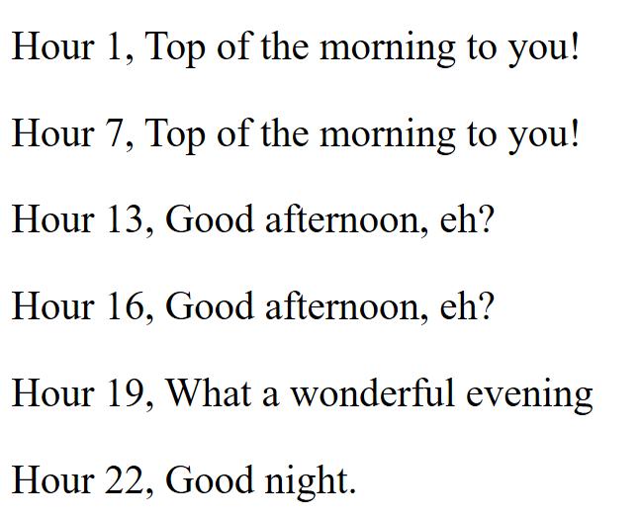
Branching Example
Branching.js
branchTest.html

Slide 26
Syntax: Branching with Switches
switch (expression){
case 1:
//if expression == 1 do this
case 2:
//if expression == 1 or 2 do this
break;
case 3:
//if expression == 3 do this
break;
default:
// if expression != 1 and != 2 and != 3
//do this
}

Slide 27
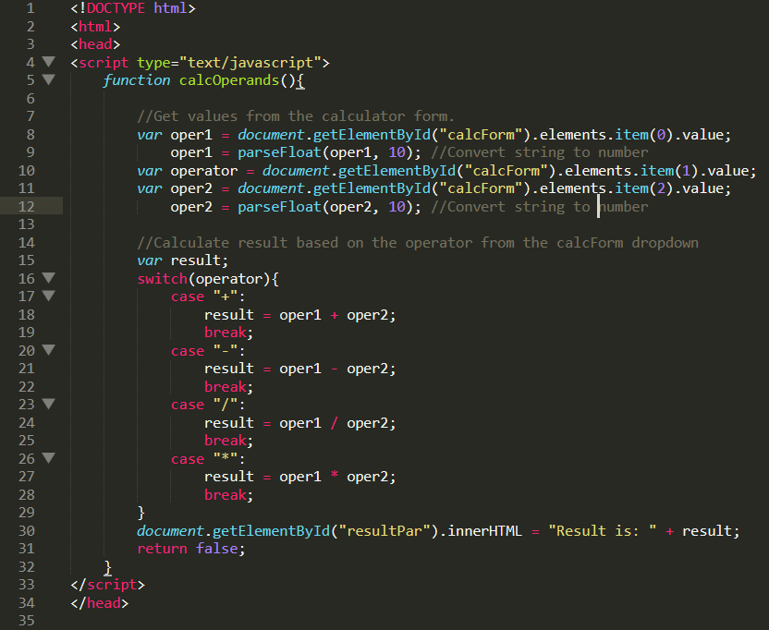
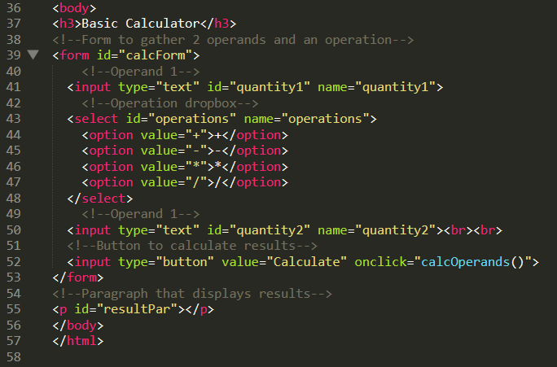
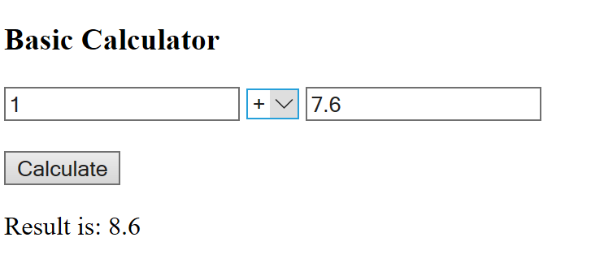
Example - Basic Calculator

Slide 28
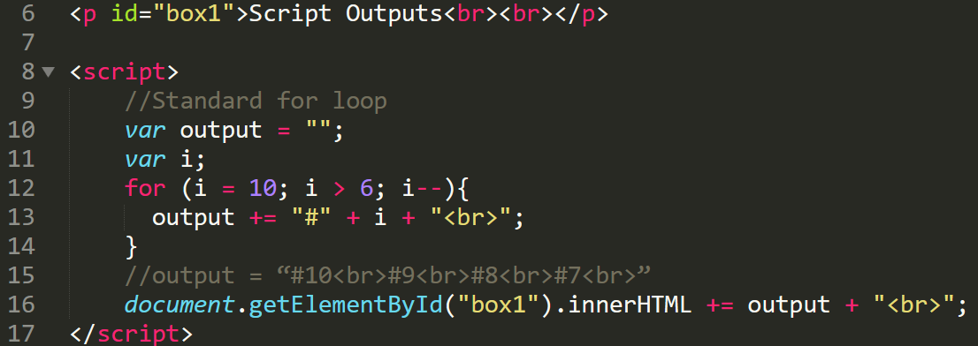
Looping –Standard for Loops
var output = “”;
var i;
for (i = 10; i > 6; i--){
output += i + “<br>”;
}
//output = “10<br>9<br>8<br>7<br>”

Slide 29
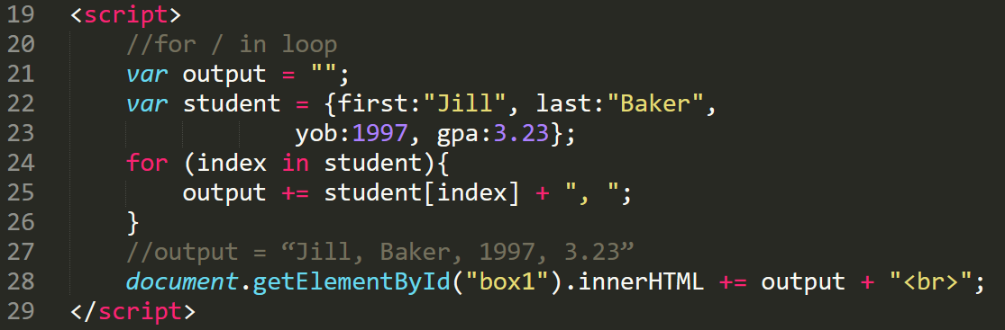
Looping – for / in Loops

Slide 30
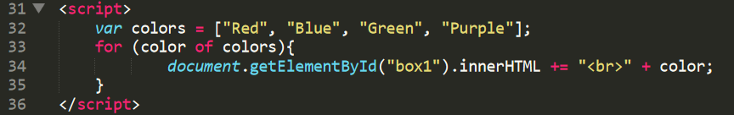
Looping - for / of Loops

Slide 31
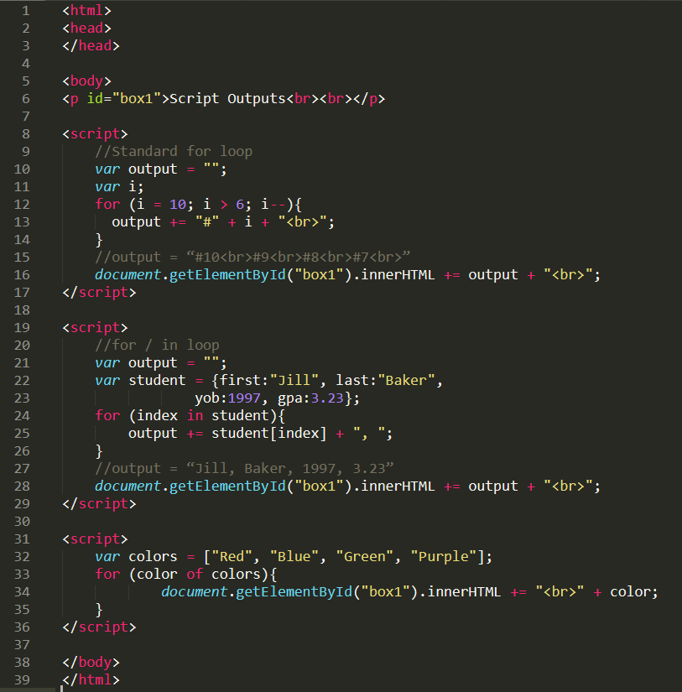
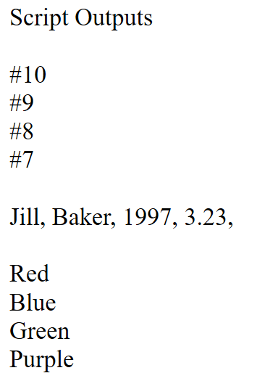

Slide 32
Looping - While Loops
while(condition){
//Do this
}
var x = 10, fact = 1;
while(x > 1){
fact *= 10;
x--;
}
document.write(fact);

Slide 33
Looping - Do-while loops
do{
//Do this at least once,
//Continue to do this if condition true
} while(condition);

Slide 34
Async-Await and Promises
JS is a synchronous language but can act like an asynchronous language using Promises.
Promises handle code that awaits a response, (timers, I/O, API calls, etc)
To do a task on the side without blocking program execution.
async marks blocks of code that will have to wait for a Promise.
await marks where the code waits for a promise. The async block waits for a promise, but the rest of the program does not..

Slide 35
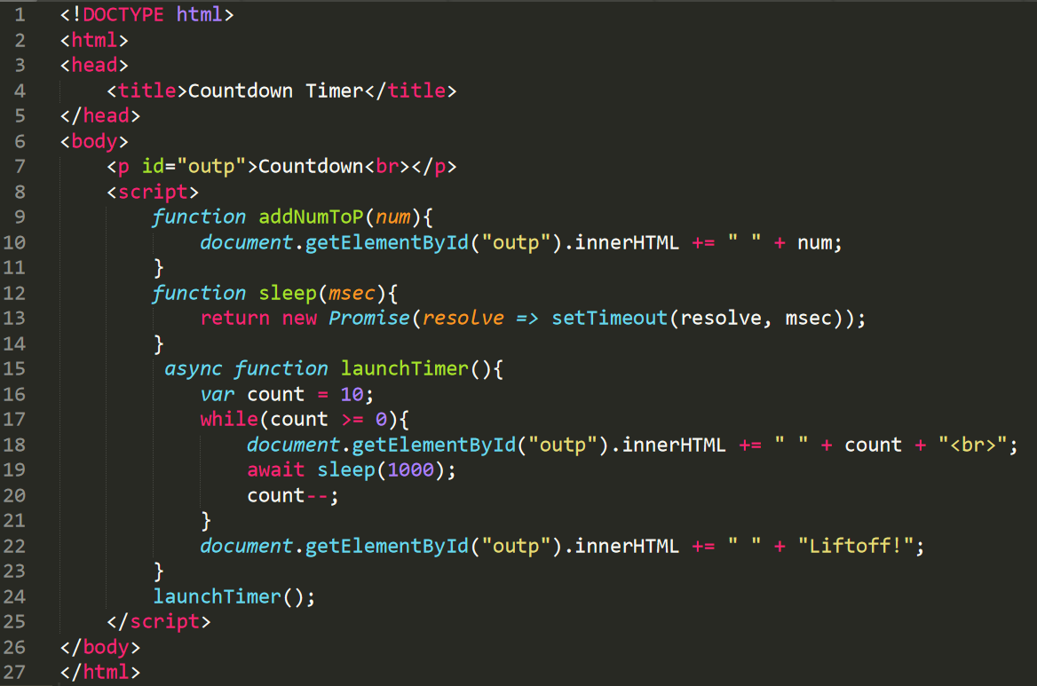
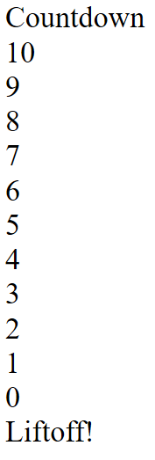
Countdown Timer

Slide 36
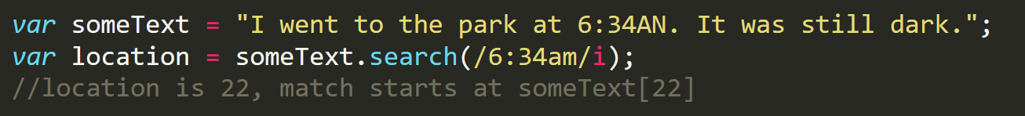
Regular Expressions and Pattern Matching
JS does support pattern matching as do other scripting languages
Patterns placed between a set of forward slashes followed by any match flags
/<pattern>/flags
One example, string searching
Some Patterns
[abd] – Find any of the characters in brackets
[4-8] – Find any of the values in the range
(car|bus|truck) – Find any of the patterns separated by |
Just an intro, other ways to match, other flags available

Slide 37
JSON – JavaScript Object Notation
Common format used to store and transport data. (Think .xls .vcf or .csv)
Nested Java objects, name/value pairs
Example
{
“name”: “George”,
“age”: 37,
“rating”: 4.1,
“country”: “India”,
“pets”: [“Spike”, “Lilly”, “Spot”]
}

Slide 38
This is just the beginning. There is much more to learn about JavaScript!

